Slide 1

GPA and CGPA Calculation:
An HCI Project
Group Members:
Ibrar Ul Hassan Shami
Aqsa Shezadi
UW-23-CY-BS-18
UW-23-CY-BS-021

Slide 2
OVERVIEW
Introduction to GPA & CGPA Calculation
GPA (Grade Point Average) and CGPA (Cumulative Grade Point Average) are fundamental metrics that define a student's academic standing. They synthesize individual course grades into a single, comprehensive score, crucial for scholarships, internships, and postgraduate admissions.
Traditionally, calculating these metrics manually is a tedious and error-prone task. Our project tackles this challenge head-on by introducing an automated, highly efficient, and user-friendly system. The primary goal is to eliminate manual calculation burdens, providing students with an accurate and real-time reflection of their academic progress. This tool empowers students to monitor their performance, identify areas for improvement, and make informed academic decisions with unprecedented ease.

Slide 3

The Problem with Existing Calculation Tools
While numerous online calculators exist, many fail to meet basic usability standards. Students frequently encounter difficulties due to non-intuitive design, leading to incorrect data entry and frustration. Key issues include ambiguous input fields for grades and credits, a lack of clear instructions, and an absence of immediate feedback, making it hard to identify errors before submission.
These shortcomings can severely impact academic planning. Inaccurate calculations can lead to misplaced academic goals, missed opportunities, and significant stress. The current landscape highlights a critical need for tools that prioritize user experience, ensuring accuracy and fostering confidence in academic assessments.

Slide 4
Recurring Issues in Existing Systems
A comprehensive analysis of current GPA/CGPA calculators reveals a pattern of neglect for user experience, despite their functional capabilities. Existing platforms often prioritize raw calculation over intuitive design.
Confusing Input Forms
No Guidance
Lack of clear labels and error prevention mechanisms.
Absence of instructions for grading scales and credit input.
High Cognitive Load
Poor Learnability
The bulk of information increases confusion.
Novice users have difficulty learning how to use the system.
These issues collectively lead to significant user frustration and reduce the reliability of the results, underscoring the need for a more thoughtful design approach.

Slide 5
INNOVATION
Our Solution: An Intuitive & Intelligent Calculator
We have developed an interactive CGPA calculator that stands apart through its unwavering focus on user experience. Our solution offers clear input validation and provides real-time feedback, guiding users through each step of the calculation process.
The system is versatile, supporting multiple grading scales (4.0, 5.0, 10.0) and intelligently handling credit weighting to ensure precise results. Its responsive design guarantees seamless functionality across all devices, from desktops to mobile phones. The core novelty lies in its deep integration of Human-Computer Interaction (HCI) principles, designed to minimize cognitive load and maximize user satisfaction. Furthermore our approach offers insightful data representations, transforming raw numbers into actionable insights for students.

Slide 6

HCI Impact: Addressing Usability Challenges
The deficiencies in existing GPA/CGPA calculators have a profound HCI impact. Poor interface design directly contributes to user errors, leading to a lack of trust in the calculated results. Users are forced to invest additional mental effort, increasing cognitive load as they struggle to manually convert grades or accurately input credit hours.
Our project directly confronts these challenges by applying the PACT framework (People, Activities, Contexts, Technologies) to design. This human-centered approach ensures that the calculator is not just functional but also inherently usable, accessible, and trustworthy, thereby enhancing the overall user experience.

Slide 7





FRAMEWORK
PACT Analysis: A User-Centric Design Approach
Activities
People
Contexts
Technologies
Our design philosophy is rooted in the PACT analysis, a holistic framework that considers four critical aspects of interaction design:
People: We cater to a diverse student population, recognizing varying levels of tech proficiency, academic backgrounds, and specific needs.
Activities: The core activities involve accurate grade input, efficient GPA/CGPA calculation, intuitive interpretation of results, and effective academic planning.
Contexts: Our solution is designed for versatile use across mobile and desktop environments, accommodating varying internet connectivity and diverse educational settings.
Technologies: We leverage a web-based platform with a responsive UI, real-time validation for immediate feedback, and advanced visual analytics for clearer insights.
This meticulous analysis ensures enhanced usability, unparalleled accuracy, and ultimately, superior user satisfaction.

Slide 8





Our Comprehensive Research Methodology
Literature Review
Examined existing GPA/CGPA calculation methods and tools to identify best practices and common pitfalls.
User Interviews & Surveys
Conducted in-depth interviews and surveys to gather direct feedback on pain points and user expectations from current systems.
Rough Sketches on Paper
Designed rough sketches
Iterative Design & Prototyping
Developed a digital prototype, refining the user interface and experience based on continuous feedback and usability testing.
Technical Implementation
Implemented the calculator using modern web technologies (JavaScript, HTML, CSS) to ensure responsiveness and robust functionality.

Slide 9
Key Findings from User Interviews
Interviews with students provided invaluable insights, highlighting critical areas for improvement in academic tools. These findings directly shaped the design and features of our GPA/CGPA calculator.
Confusion over Grading Scales: Many students expressed difficulty understanding and correctly inputting grades according to various institutional grading scales and credit systems.
Desire for Instant Feedback: A strong preference emerged for immediate error feedback and clear, concise instructions within the calculator interface.
Preference for Task Based Approach: Many of the students demanded that the web should ask them for the number of subject and semesters when calculation GPA & CGPA respectively.
Criticality of Mobile Access: The ability to access the calculator on mobile devices for on-the-go tracking and quick checks was deemed essential.
Our design directly addresses these identified needs, aiming to boost user confidence, enhance engagement, and provide a truly empowering academic tool.

Slide 10


Personas: Understanding Our Users
To create a truly user-centric GPA and CGPA calculator, we first delved into understanding our primary users. We identified three distinct personas, each with unique needs and challenges.
Ali Raza: Local GPA Focused Student
Noor Fatima: Student Looking to study abroad
Ali Raza is a second-year cybersecurity undergraduate who frequently checks his GPA each semester. He prefers reliable online tools over manual calculations and needs clear, accurate GPA and CGPA results with simple explanations to avoid confusion and reduce academic anxiety.
Noor Fatima is a fifth-semester cybersecurity undergraduate planning to study abroad. She needs a reliable tool to calculate her CGPA and instantly interpret it against international grading standards so she can confidently assess her eligibility without confusion or anxiety.

Slide 11
Scenarios: Real-Life Use Cases
By developing detailed scenarios for each persona, we gained insight into how our application would integrate into their daily academic lives. These scenarios highlighted critical moments and functionalities required for a successful user experience.
Scenario for Ali Raza
Scenario for Noor Fatima
After getting his results, Ali uses online GPA calculators but receives different results with no explanation of credit hours. He wants a single reliable tool that gives accurate GPA results with clear, step-by-step calculation transparency.
While preparing to study abroad, Fatima calculates her CGPA but struggles to understand how it is evaluated internationally. She wants a simple tool where she enters her CGPA, selects a country, and receives clear explanations to reduce confusion and decision fatigue.

Slide 12

Sketching Our Idea: From Concept to Interface
The initial phase of our design process involved extensive sketching to rapidly explore various interface concepts. This allowed us to iterate quickly and visually represent our ideas before committing to digital prototypes.
We brainstormed numerous design ideas, prioritizing simplicity, clarity, and ease of use for all our personas.
Rough sketches were created to explore different input methods for grades and credits, as well as various ways to display calculated GPA and CGPA results.
After evaluating multiple concepts, we selected two promising sketches. These were chosen for their potential to address the diverse needs of our users and were further developed into detailed UI storyboards and task flows.

Slide 13
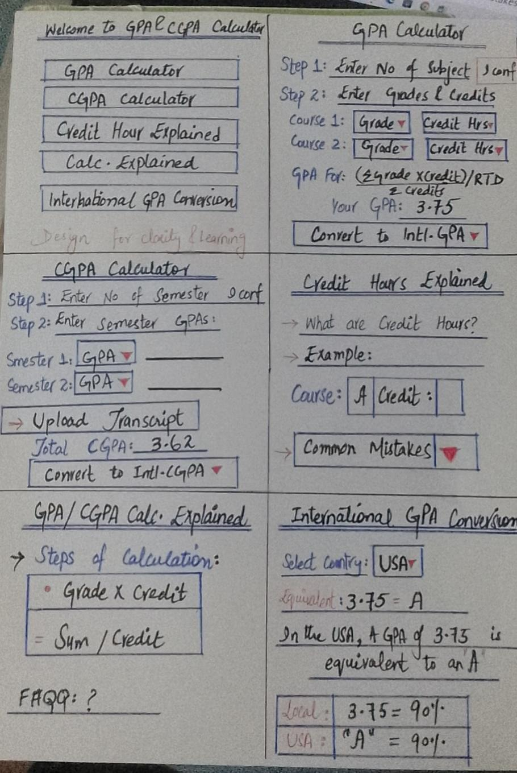
Sketch 1: ☺

Slide 14
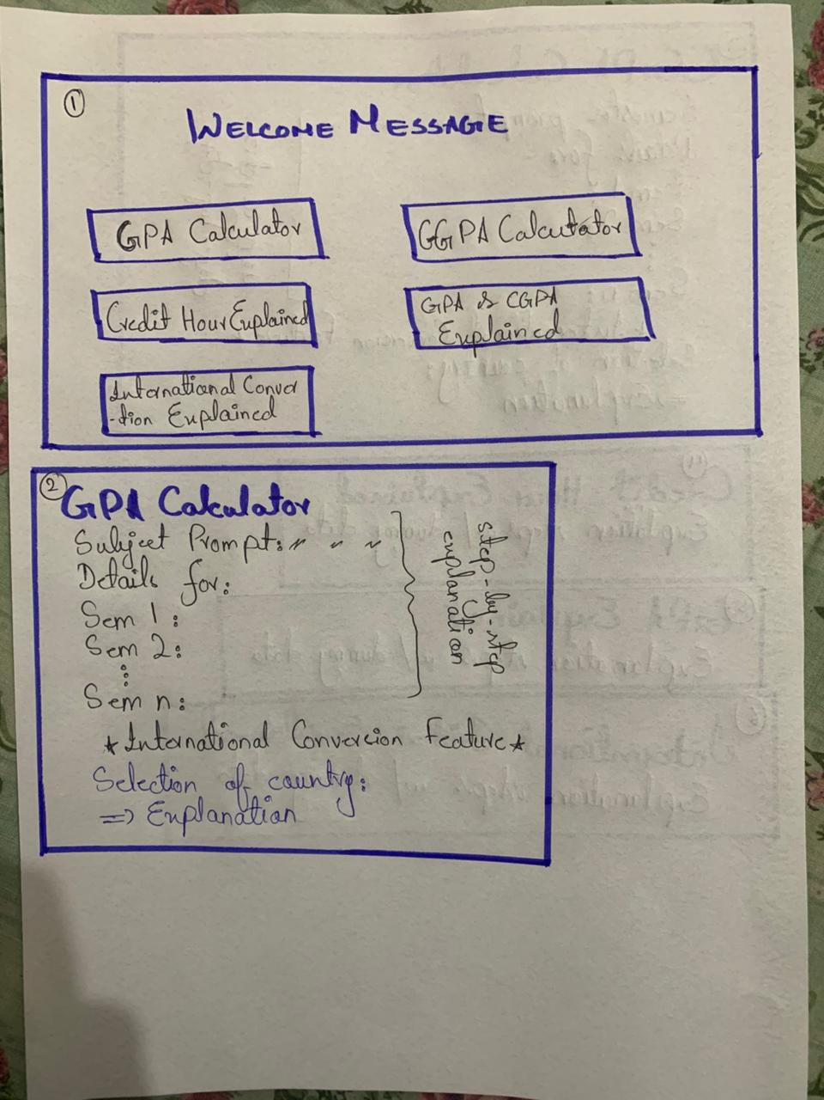
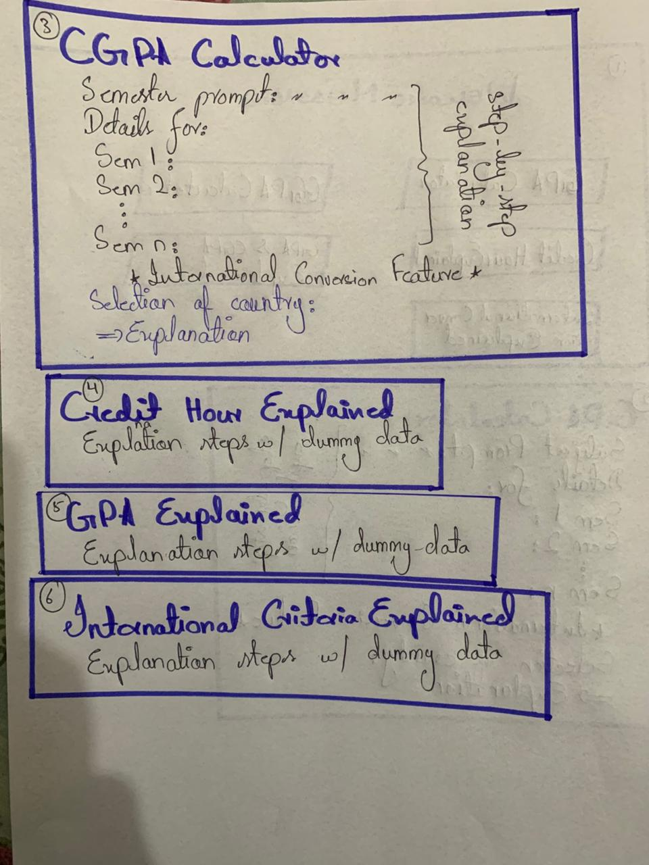
Sketch 2: ☹

Slide 15

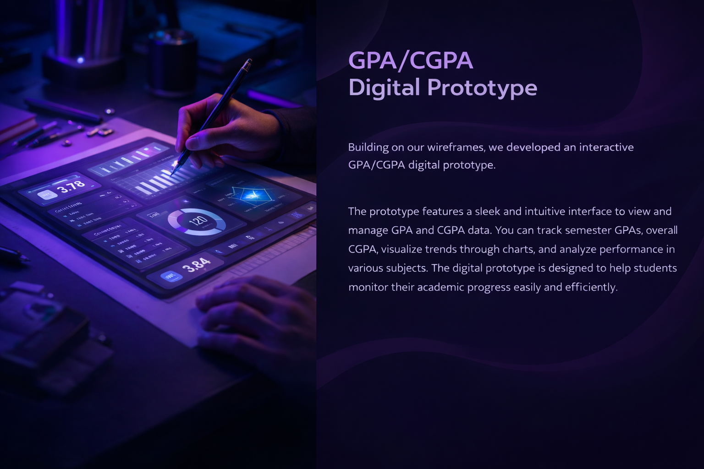

Slide 16
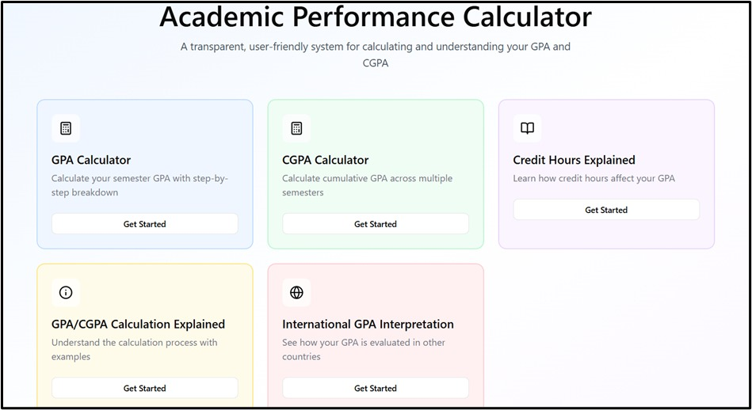
Welcome Page

Slide 17
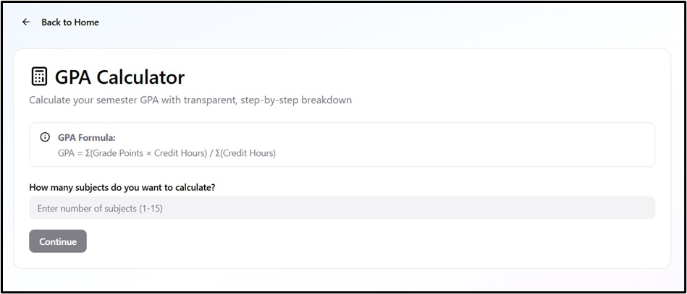
GPA Calculator

Slide 18
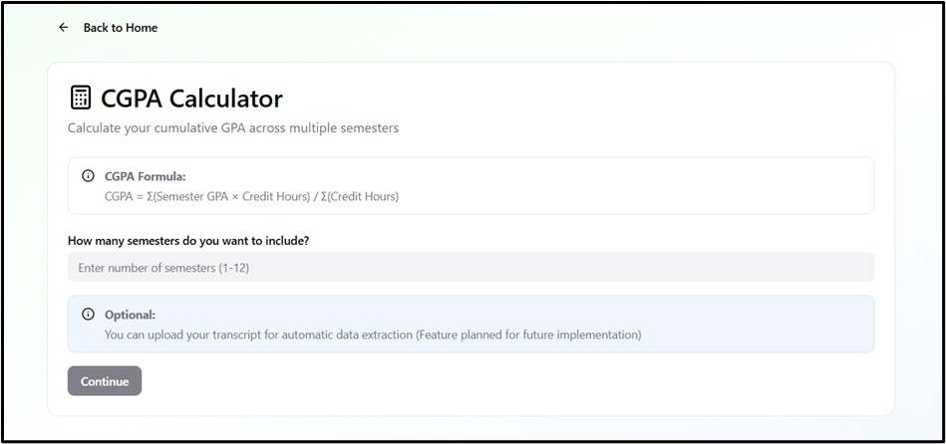
CGPA Calculator

Slide 19
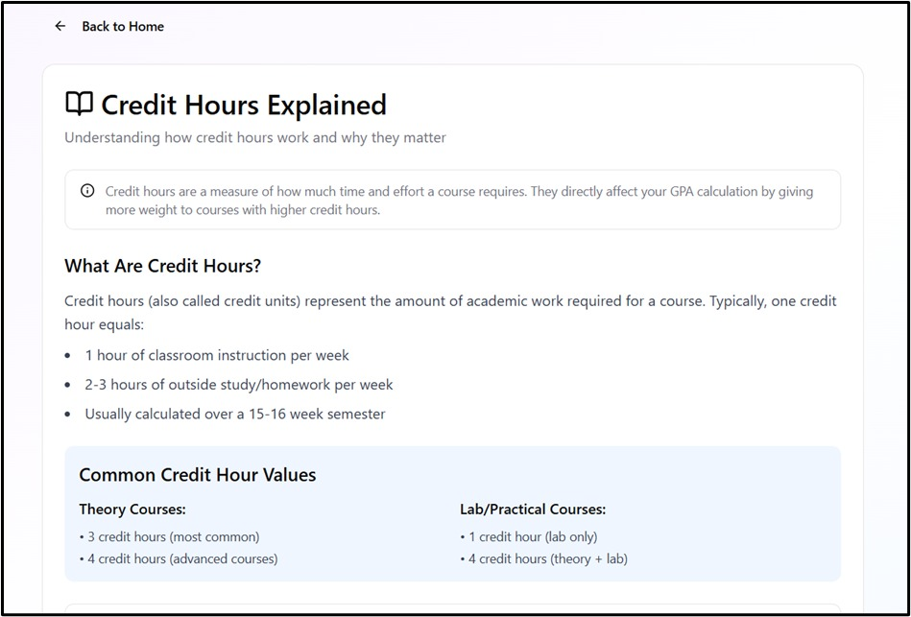
Credit Hours Explained

Slide 20
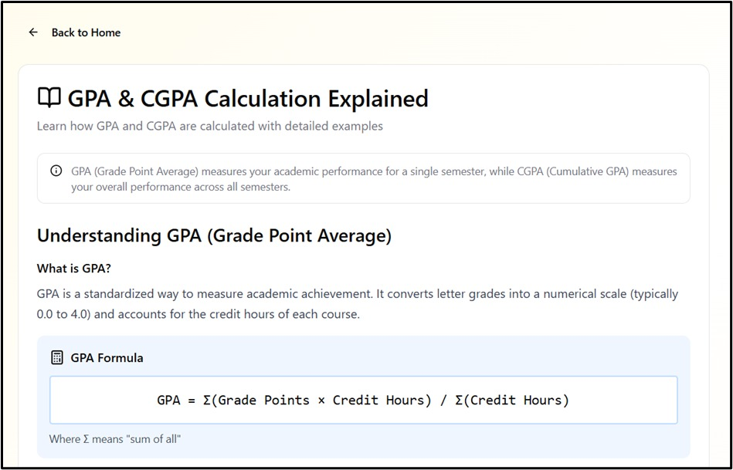
GPA/CGPA Explained

Slide 21
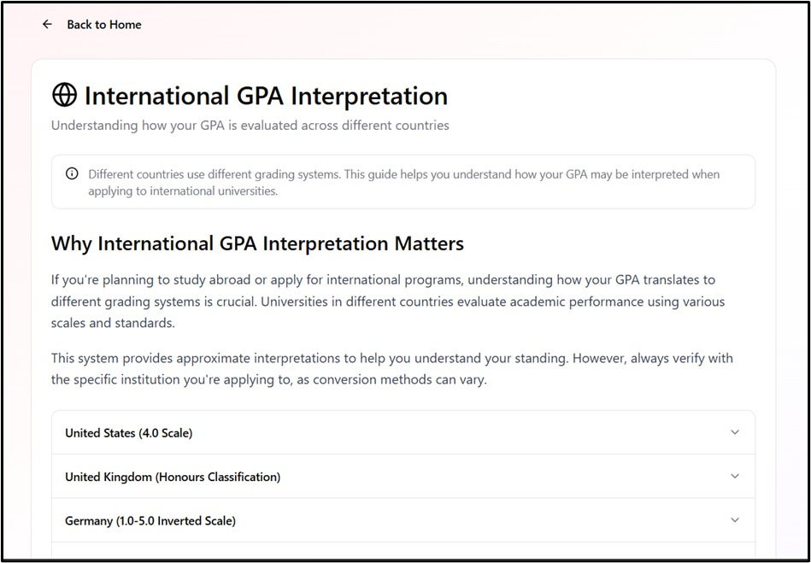
International GPA Interpretation

Slide 22
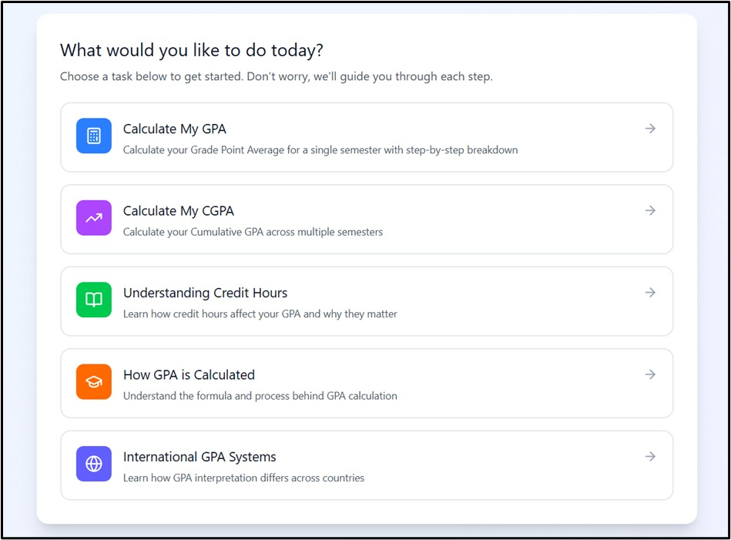
Website: Link

Slide 23


